Slide 1
Case Presentation:
Erosions on the scalp in a 72-year old man
Amanda Ederle, BSEd¹
Malan Kern, MD²
¹College of Medicine; ²Department of Dermatology
University of Arkansas for Medical Sciences

Slide 2
Presentation
72-year old man presented to clinic with erosions on his scalp
Began about 6 months ago
Started as blisters and progressed to shallow erosions
Denied any associated pain or itching
Patient has never had similar lesions before
Denied a history of blistering of the mouth, eyes, nose, or genitals
ROS: unremarkable

Slide 3
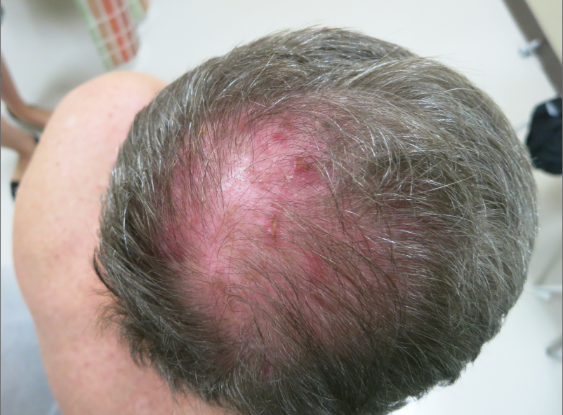
Notes:
IMAGE DESCRIPTION: multiple erythematous erosions with hemorrhagic crusting were noted on his scalp

Slide 4
Assessment
72 yo M with a 6-month history of non-tender, non-pruritic shallow erosions on his scalp.
Differential Diagnosis
actinic keratosis
lichen planopilaris
erosive pustular dermatosis of the scalp
neurotic excoriations
mucous membrane pemphigoid
Biopsy for H&E and DIF

Slide 5
Notes:
MICROSCOPIC DESCRIPTION: H&E stain showing subepidermal blister with mixed infiltrate in dermis

Slide 6
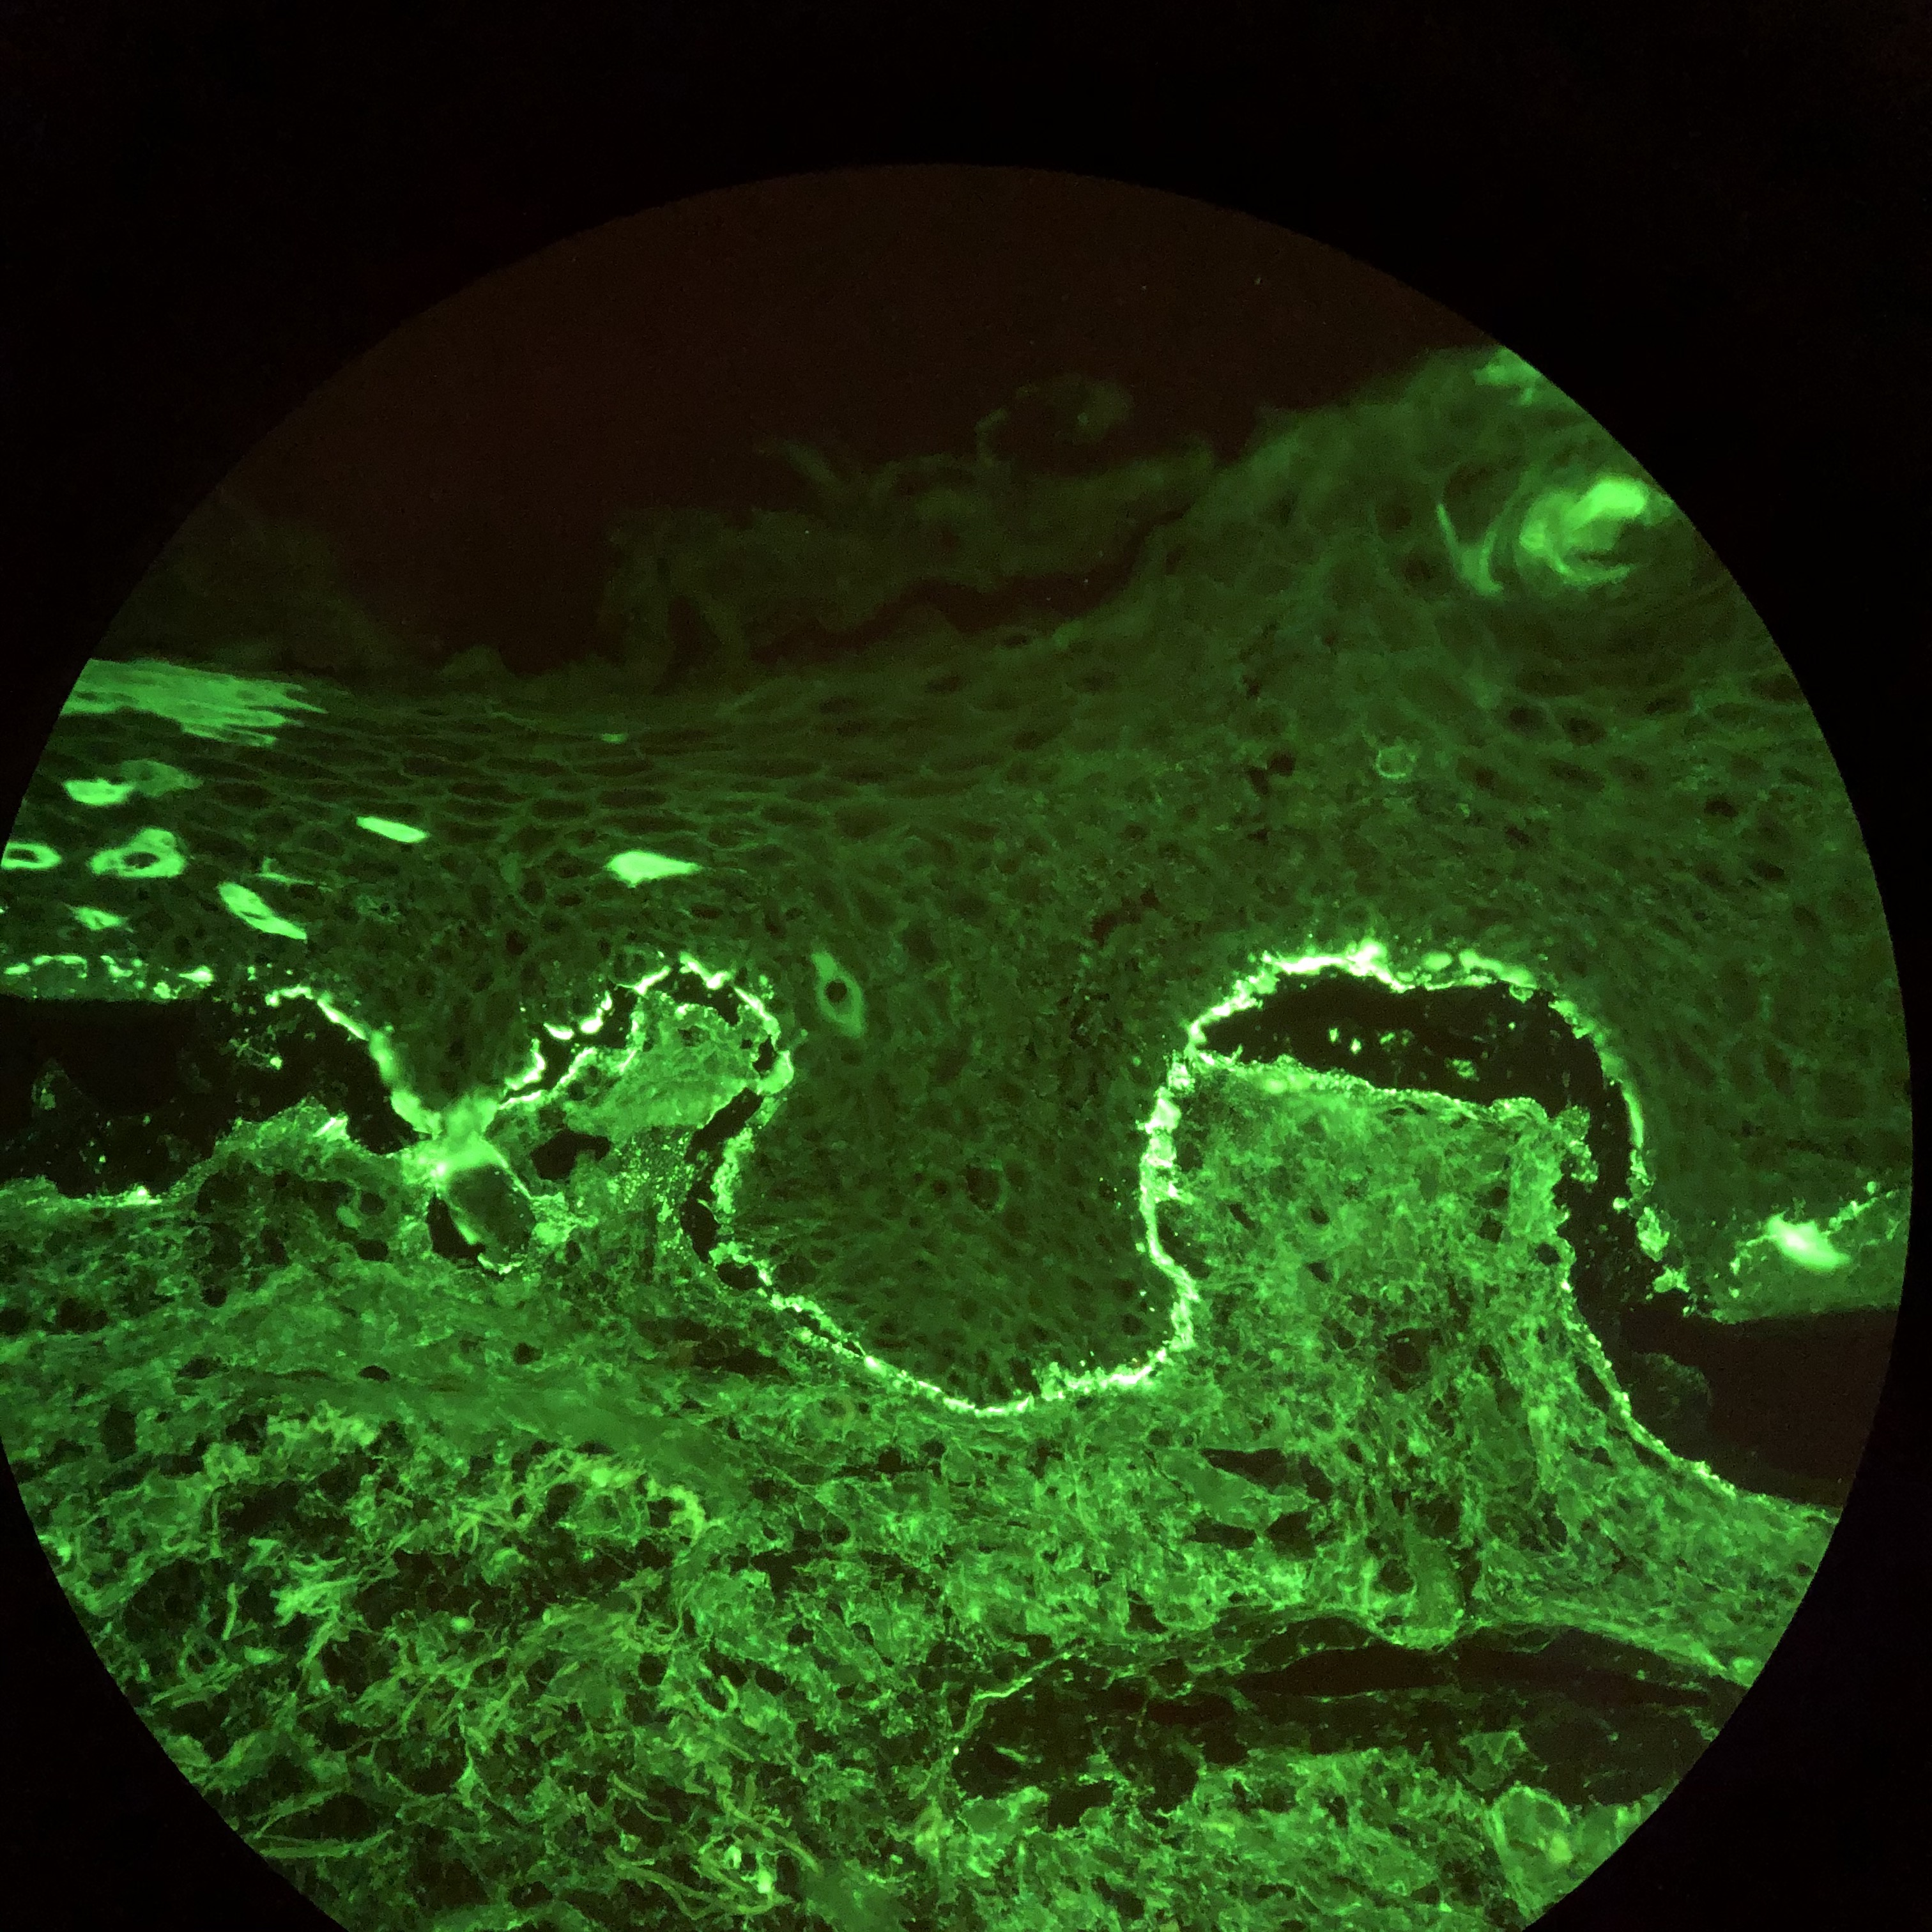
Notes:
MICROSCOPIC DESCRIPTION: Direct immunofluorescence with linear IgG staining basement membran( above); similar pattern also noted for C3 (not shown)

Slide 7
Mucous Membrane Pemphigoid (MMP)
Autoimmune condition
Subepithelial blistering due to linear deposition of IgG, IgA, C3 along basement membrane¹
Frequency of involvement:
oral mucosa (85%)
ocular conjunctiva (64%)
skin (24%),
pharynx (19%)²
Commonly cause scarring, leading to the morbidity and even mortality associated with this disease³
Brunsting-Perry variant: commonly affects older men and is confined to the head or neck without mucosal involvment⁴.

Slide 8
MMP Brunsting-Perry Presentation
More common in older men
Confined to the head or neck without mucosal involvment⁴
Typically starts as urticarial plaque and enlarge
Blister along the edges of the plaque
Plaques heal over months with scarring
Image Source: Jedlickova et al. (2011)⁴

Slide 9
Management of MMP
Mild Disease
Alternatively, can use topical tacrolimus and intralesional corticosteroids^{5,6}
Moderate-Severe Disease
Serve and Refractory Disease
First line: topical corticosteroids
Recommend tapering after remission
Systemic steroids
Systemic steroids, azathioprine, mycophenolate mofetil, IVIG, rituximab
Doxycycline and nicotinamide
Dapsone

Slide 10
Clinical Course
0.05% clobetasol BID
100mg doxycycline BID
Initial Appointment
500mg nicotinamide QID
0.05% fluocinonide QID
500mg nicotinamide QID
100mg doxycycline BID
3 Months Later
Notes:
Three months later: emergence of new spots 2x a week

Slide 11
Conclusion
Autoimmune subepithelial blistering due to linear deposition of IgG, IgA, C3 along basement membrane¹
Biopsy with DIF is diagnostic
MMP typically involves mucosal surfaces
Brunsting-Perry variant is more prevalent in older men and does not involve the mucosa
A high index of suspicion is needed to diagnose Brunsting-Perry pemphigoid given the broad differential diagnosis
Management includes topical or systemic steroids along with other immunomodulating therapies

Slide 12
References
Chan LS, Ahmed AR, Anhalt GJ, et al. The first international consensus on mucous membrane pemphigoid: definition, diagnostic criteria, pathogenic factors, medical treatment, and prognostic indications. Arch Dermatol 2002; 138:370.
Ahmed AR, Hombal SM. Cicatricial pemphigoid. Int J Dermatol 1986; 25-90.
Fleming TE, Korman NJ. Cicatricial pemphigoid. J Am Acad Dermatol 2000; 43:571.
Jedlickova H, Niedermeier A, Zgazarova S, Hertl M. Brunsting-Perry pemphigoid of the scalp with antibodies against laminin 332. Dermatology 2011; 222:193.
Lee HY, Blazek C, Beltraminelli H, Borradori L. Oral mucous membrane pemphigoid: complete response to topical tacrolimus. Acta Derm Venereol 2011; 91:604
Assmann T, Becker J, Ruzicka T, Megahed M. Topical tacrolimus for oral cicatricial pemphigoid. Clin Exp Dermatol 2004; 29:674.

